Slide 1
HTML5
Web Application Course
Instructor: Osama Alkhoun

Slide 2
HTML5
Chapter 01

Slide 3
HTML5 Tutorial
With HTML you can create your own Web site.
This tutorial teaches you everything about HTML.
HTML is easy to learn - You will enjoy it.

Slide 4
HTML Introduction
What is HTML?
HTML is the standard markup language for creating Web pages.
HTML stands for Hyper Text Markup Language
HTML describes the structure of Web pages using markup
HTML elements are the building blocks of HTML pages
HTML elements are represented by tags
HTML tags label pieces of content such as "heading", "paragraph", "table", and so on
Browsers do not display the HTML tags, but use them to render the content of the page

Slide 5
HTML Tags
HTML tags are element names surrounded by angle brackets:
<tagname>content goes here...</tagname>
HTML tags normally come in pairs like <p> and </p>
The first tag in a pair is the start tag, the second tag is the end tag
The end tag is written like the start tag, but with a forward slash inserted before the tag name.

Slide 6
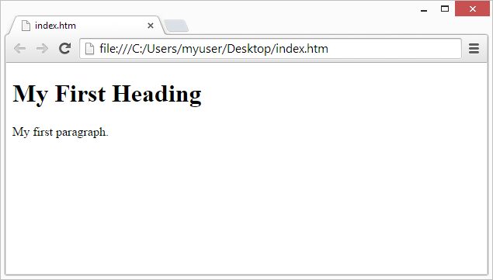
Web Browsers
The purpose of a web browser (Chrome, IE, Firefox, Safari) is to read HTML documents and display them.
The browser does not display the HTML tags, but uses them to determine how to display the document:

Slide 7
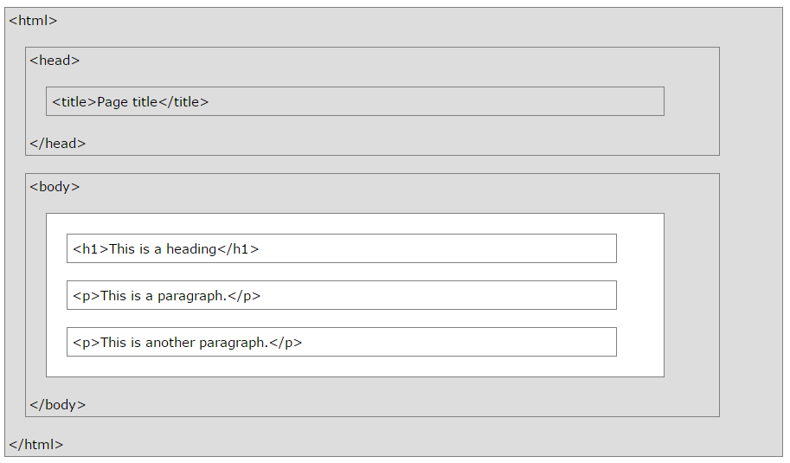
HTML Page Structure

Slide 8
HTML Versions
Since the early days of the web, there have been many versions of HTML:
Version | Year
HTML | 1991
HTML 2.0 | 1995
HTML 3.2 | 1997
HTML 4.01 | 1999
XHTML | 2000
HTML5 | 2014

Slide 9
HTML Editors
Write HTML Using Notepad or TextEdit
Web pages can be created and modified by using professional HTML editors.
However, for learning HTML we recommend a simple text editor like Notepad (PC) or TextEdit (Mac).
We believe using a simple text editor is a good way to learn HTML.
Follow the four steps below to create your first web page with Notepad or TextEdit.

Slide 10
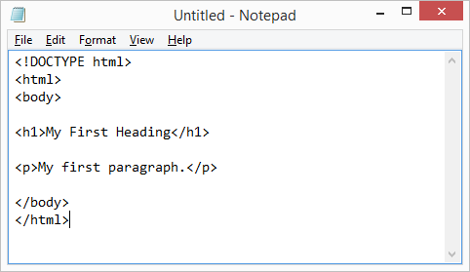
First page in html
Step 1: Open Notepad (PC)
Step 2: Write Some HTML

Slide 11
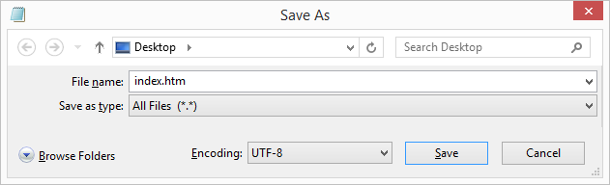
First page in html (cont.)
Step 3: Save the HTML Page
Save the file on your computer. Select File > Save as in the Notepad menu.
Name the file "index.htm" and set the encoding to UTF-8 (which is the preferred encoding for HTML files).

Slide 12
First page in html (cont.)
Step 4: View the HTML Page in Your Browser
Open the saved HTML file in your favorite browser (double click on the file, or right-click - and choose "Open with").
The result will look much like this:

Slide 13
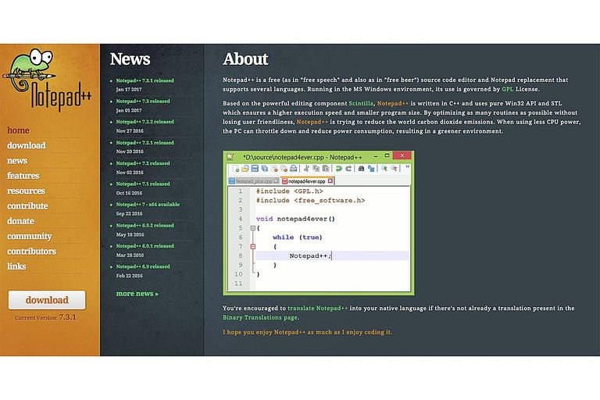


Other Tools for Write HTML Using
Notepad ++
KOMODO EDIT
ECLIPSE

Slide 14




Other Tools for Write HTML Using
COFFEECUP FREE HTML EDITOR
APTANA STUDIO
NETBEANS
MICROSOFT VISUAL STUDIO COMMUNITY

Slide 15



Other Tools for Write HTML Using
BLUEGRIFFON
BLUEFISH
EMACS PROFILE

Slide 16

Other Tools for Write HTML Using
RAPID PHP TOOLS
The main tool to write HTMl in in This Course

Slide 17
HTML Documents
All HTML documents must start with a document type declaration: <!DOCTYPE html>.
The HTML document itself begins with <html> and ends with </html>.
The visible part of the HTML document is between <body> and </body>.

Slide 18
Example

Slide 19
HTML Headings
HTML headings are defined with the <h1> to <h6> tags.
<h1> defines the most important heading. <h6> defines the least important heading:
<h1>This is heading 1</h1> <h2>This is heading 2</h2> <h3>This is heading 3</h3>

Slide 20
HTML Paragraphs
HTML paragraphs are defined with the <p> tag:
<p>This is a paragraph.</p> <p>This is another paragraph.</p>

Slide 21
HTML Links
HTML links are defined with the <a> tag:
<a href="https://www.OsamaAlkhoun.com">This is a link</a>
The link's destination is specified in the href attribute.
Attributes are used to provide additional information about HTML elements.

Slide 22
HTML Images
HTML images are defined with the <img> tag.
The source file (src), alternative text (alt), width, and height are provided as attributes:
<img src=“card.jpg" alt=“OsamaAlkhoun.com" width="100" height="150">

Slide 23
HTML Elements
An HTML element usually consists of a start tag and end tag, with the content inserted in between:
<tagname>Content goes here...</tagname>
The HTML element is everything from the start tag to the end tag:
<p>My first paragraph.</p>
Start tag | Element content | End tag
<h1> | My First Heading | </h1>
<p> | My first paragraph. | </p>
<br>
Notes:
HTML elements with no content are called empty elements. Empty elements do not have an end tag, such as the <br> element (which indicates a line break).

Slide 24
Nested HTML Elements
HTML elements can be nested (elements can contain elements).
All HTML documents consist of nested HTML elements.
This example contains four HTML elements:

Slide 25
Previous Example Explained
The <html> element defines the whole document.
It has a start tag <html> and an end tag </html>.
The element content is another HTML element (the <body> element).
The <body> element defines the document body.
It has a start tag <body> and an end tag </body>.
The element content is two other HTML elements (<h1> and <p>).

Slide 26
Previous Example Explained
The <h1> element defines a heading.
It has a start tag <h1> and an end tag </h1>.
The element content is: My
The <p> element defines a paragraph.
It has a start tag <p> and an end tag </p>.
The element content is: My first paragraph.
First Heading.

Slide 27
Do Not Forget the End Tag
Some HTML elements will display correctly, even if you forget the end tag:
The example above works in all browsers, because the closing tag is considered optional.
Never rely on this. It might produce unexpected results and/or errors if you forget the end tag.

Slide 28
Empty HTML Elements
HTML elements with no content are called empty elements.
<br> is an empty element without a closing tag (the <br> tag defines a line break).
Empty elements can be "closed" in the opening tag like this: <br />.
HTML5 does not require empty elements to be closed. But if you want stricter validation, or if you need to make your document readable by XML parsers, you must close all HTML elements properly.

Slide 29
Use Lowercase Tags
HTML tags are not case sensitive: <P> means the same as <p>.
The HTML5 standard does not require lowercase tags, but W3C recommends lowercase in HTML, and demands lowercase for stricter document types like XHTML.

Slide 30
HTML Attributes
Attributes provide additional information about HTML elements.
HTML Attributes
All HTML elements can have attributes
Attributes provide additional information about an element
Attributes are always specified in the start tag
Attributes usually come in name/value pairs like: name="value"

Slide 31
The Lang Attribute
The language of the document can be declared in the <html> tag.
The language is declared with the lang attribute.
Declaring a language is important for accessibility applications (screen readers) and search engines:

Slide 32
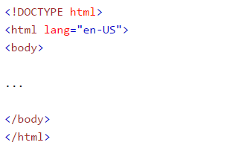
The Lang Attribute (cont.)
The first two letters specify the language (en). If there is a dialect, use two more letters (US).

Slide 33

The title Attribute
Here, a title attribute is added to the <p> element. The value of the title attribute will be displayed as a tooltip when you mouse over the paragraph:

Slide 34
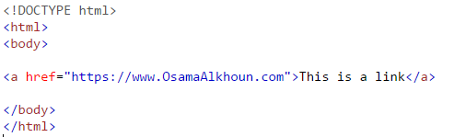
The href Attribute
HTML links are defined with the <a> tag. The link address is specified in the href attribute:

Slide 35
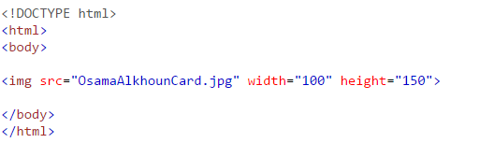
Size Attributes
HTML images are defined with the <img> tag.
The filename of the source (src), and the size of the image (width and height) are all provided as attributes:
The image size is specified in pixels: width="100" means 150 screen pixels wide.

Slide 36
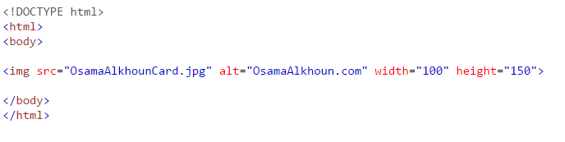
The alt Attribute
The alt attribute specifies an alternative text to be used, when an image cannot be displayed.
The value of the attribute can be read by screen readers. This way, someone "listening" to the webpage, e.g. a blind person, can "hear" the element.

Slide 37
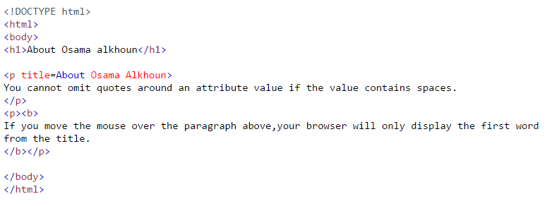
We Suggest: Quote Attribute Values
Title for paragraph without quote

Slide 38
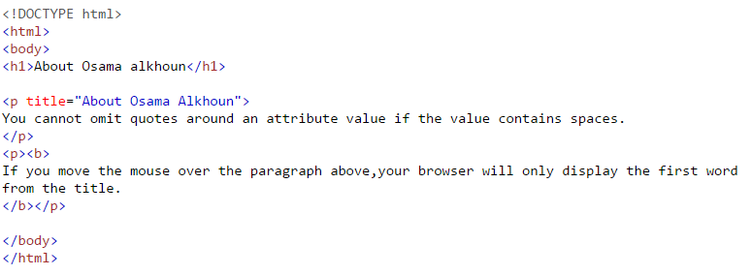
We Suggest: Quote Attribute Values
Title for paragraph with quote

Slide 39
Single or Double Quotes?
Double quotes around attribute values are the most common in HTML, but single quotes can also be used.
In some situations, when the attribute value itself contains double quotes, it is necessary to use single quotes:
<p title=‘Osama “M A” Alkhoun'>
<p title=" Osama ' M A ' Alkhoun">

Slide 40
Chapter Summary
All HTML elements can have attributes
The title attribute provides additional "tool-tip" information
The href attribute provides address information for links
The width and height attributes provide size information for images
The alt attribute provides text for screen readers
At W3Schools we always use lowercase attribute names
At W3Schools we always quote attribute values with double quotes

